Slide 1
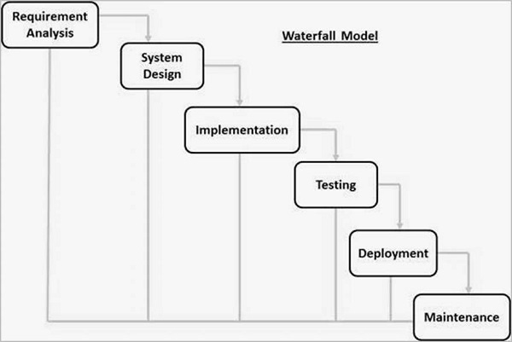
Waterfall SDLC
UI Design and Development
By Jason Palmeri
CSD200

Slide 2

Planning
User Interface Designer
During this phase the team behind the project comes together to make a list of all the possible requirements of the system that is to be developed. They are documented in a requirement specification document.
During this phase the User Interface designer is tasked with creating a user interface for the product using the requirement specification document.
Key Deliverables
Requirement Specification Document

Slide 3
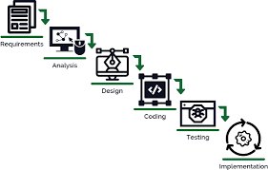
Design
User Interface Designer
During this phase the team behind the project decides what type of language the program is to be written in, like PHP, Java, .NET
They also decide on which software they will be using , and if a database is needed they choose one like MySQL or Oracle.
During this phase the User Interface designer is tasked with creating prototypes of the look of the user interface, and creating wireframes for the developers to follow
Key Deliverables
List of required programs and applications
Appropriate Software Aquired

Slide 4
Implementation
User Interface Designer
During this stage of the Waterfall SDLC the team starts to put together the program, first by building small programs called units. Each unit is developed and tested for it functionality, called Unit Testing
During this stage the User Interface designer can take feedback on their designs and make any necessary changes to them so that everything works for the client.
Key Deliverables
The whole program written out into small units

Slide 5
Integration and Testing
User Interface Designer
During this stage all the units from the previous stage are brought together and integrated into a system. Now with all the units together the program can be run and tested for any faults and failures.
As with the last stage, during this stage the User Interface Designer is again looking to see if their design is good enough for the client, and see if everything fits together and makes sense.
Key Deliverables
Prototype of the program

Slide 6
Most Important Stage?
Personally, I think that the testing stage is the most important, because nobody writes perfect code, and without a prototype, the client doesn't really know what they want. With testing you can fix and bugs that occurred during production, and you can also show the client the prototype, and they can suggest any changes that they want.

Slide 7
Cite
Point, T. (n.d.). SDLC - Waterfall Model. Retrieved November 1, 2021, from https://www.tutorialspoint.com/sdlc/sdlc_waterfall_model.htm.
Martin, M. (2021, October 7). What is waterfall model in SDLC? advantages and disadvantages. Guru99. Retrieved November 1, 2021, from https://www.guru99.com/what-is-sdlc-or-waterfall-model.html.

